Slide 1

Access to Justice
- Pravin Shinde

Slide 2

Agenda
Introduction
Background
Methodology
Result
Conclusion

Slide 3

Section 1 Introduction
Access to Justice project is an attempt to provide a web design solution that supports tenants in Westchester County to:
Understand basic information about habitability rights & resources.
To keep data regarding their housing that will better advocate for themselves.
Connect to other tenants in the community.

Slide 4

Section 2 Background
Right to live in a safe & sanitary apartment.
Process to submit a complaint or legal notice can be be ineffective, burdensome, costly, and time intensive for safety, health, environmental or livability issues in rental housing.
Limited resources
Stakeholders: -
Legal Services of the Hudson Valley.
Mount Vernon United Tenants Association.

Slide 5
Section 3 : Methodology
Empathize
Ideate
Define
Prototype
Test

Slide 6
Empathize & Define
Involved in the interviews which were conducted by Law Team with stakeholders.
Understood user perspectives and pain points.
Identified end-user’s needs.
North Star for project - User Persona & Problem definition.

Slide 7
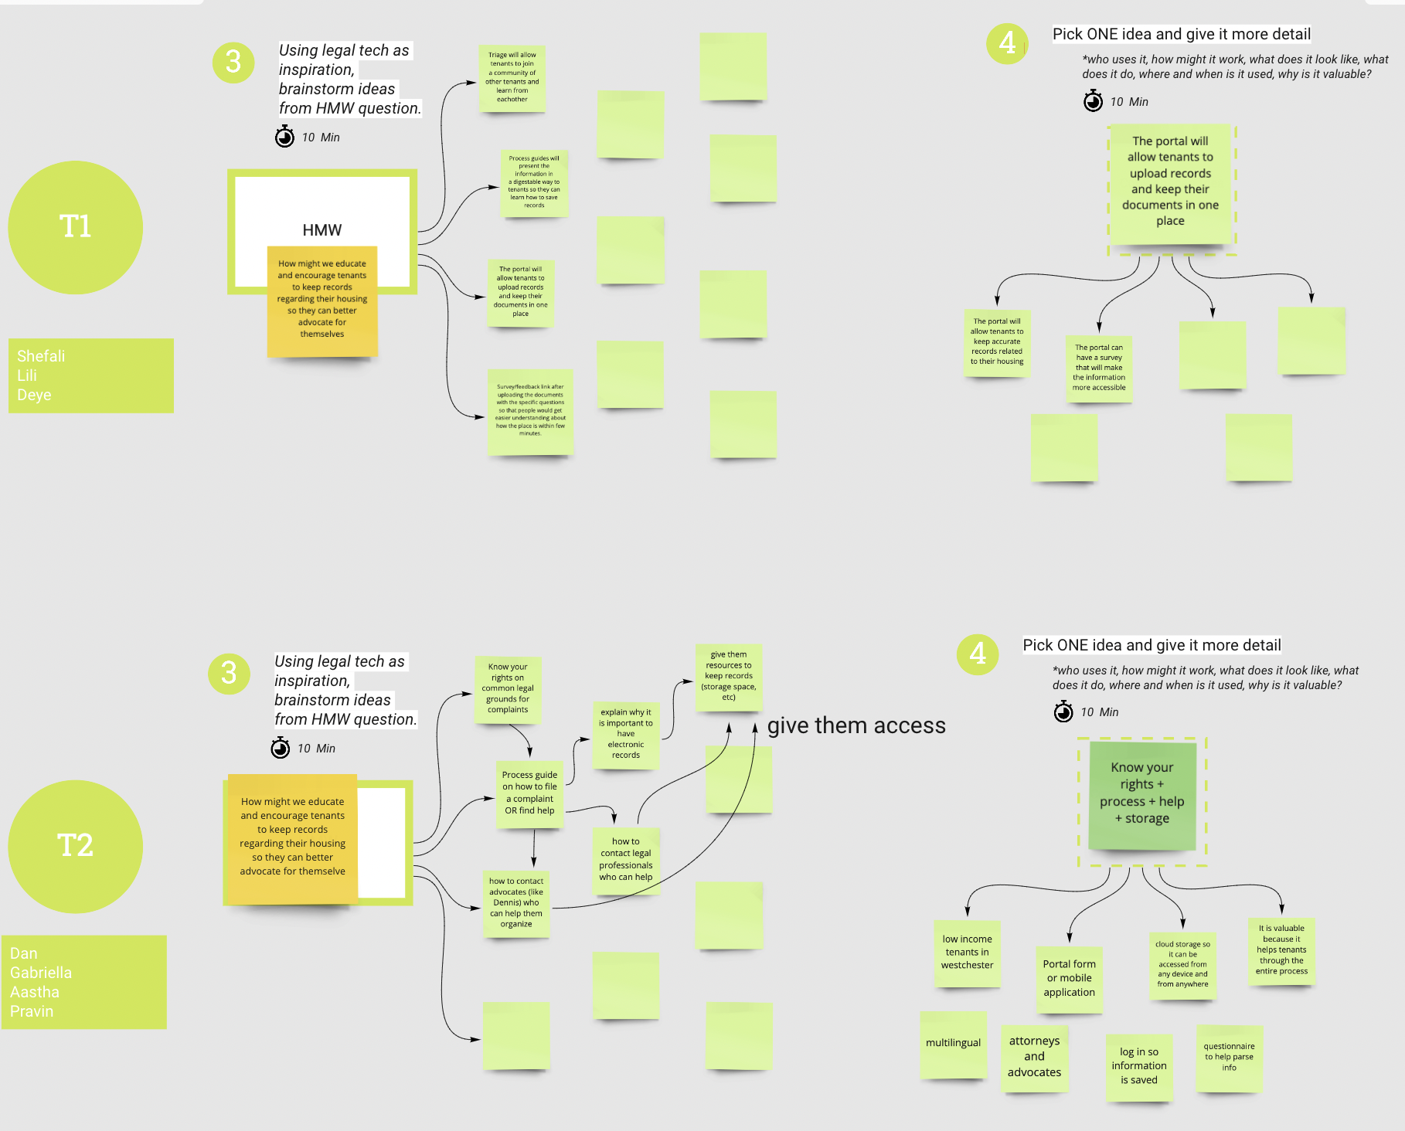
Ideate
Miro exercise to brainstorm ideas for possible solutions.
A Web application portal with key features: -
Multilingual language.
Providing basic information about habitability rights and resources.

Slide 8
Ideate
Miro exercise to brainstorm ideas for possible solutions.
A Web application portal with key features: -
Multilingual language.
Providing basic information about habitability rights and resources.
Assist tenants in record-keeping.
Forum to connect with other tenants in the community.

